Slide 1

CS4043 Games Modelling Design
Week 4 Project

Slide 2
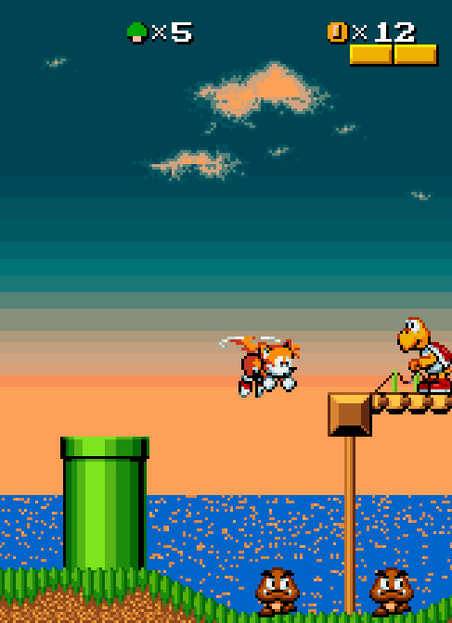
The idea
A 2D platformer
8-bit art style
Stage based level design
Time trials
Rewards for Ranks
This Photo by Unknown author is licensed under CC BY-NC-ND.

Slide 3
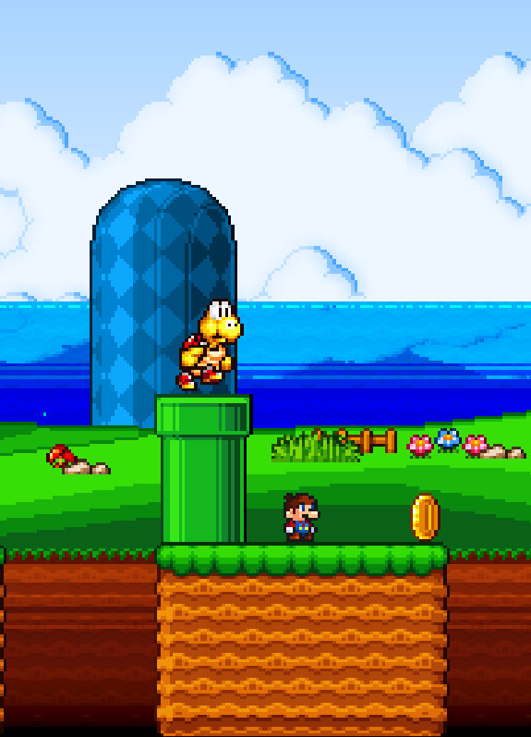
Genre and why?
2D Platformer
Inspiration from Mario and Sonic franchises
Colaborations with Students Unions reduces cost of rewards
Better than instagram giveaways!
With a large player base – incentive for SUs to donate merch in return for advertising
128,000 students in Ireland
Niche
Can be produced by a small team - inexpensive
This Photo by Unknown author is licensed under CC BY-NC-ND.

Slide 4
Stage Design
Key buildings in background
UL = "Brown Thomas", IWA, Living Bridge etc.
3 difficulties per stage
Time per stage decreases with difficulty

Slide 5


Challenges
3 difficulty levels; Bachelors, Masters, Doctoral
Enemies/Obstacles increase with level
Leaderboards for each level of difficulty
'Specter' of best time displayed per stage
Allows players to see the best run while playing
Increases competetiveness

Slide 6
Target audience
Focus on Freshers
Players declare their university when signing up
Engage players by showing the top 3 times in each university
Offer rewards such as merch from each university (i.e the top 3 UL players each month receive a free hoodie)

Slide 7

Unique selling point
A university-based platformer
Rewards players skills
Adds competetiveness
No need for micro transactions
Potential to create a social enviroment
Can be monetised with ads
Potential for special events (Freshers, ReFreshers, RaG week etc.)

Slide 8

Thank you for youre time

